Slide 1
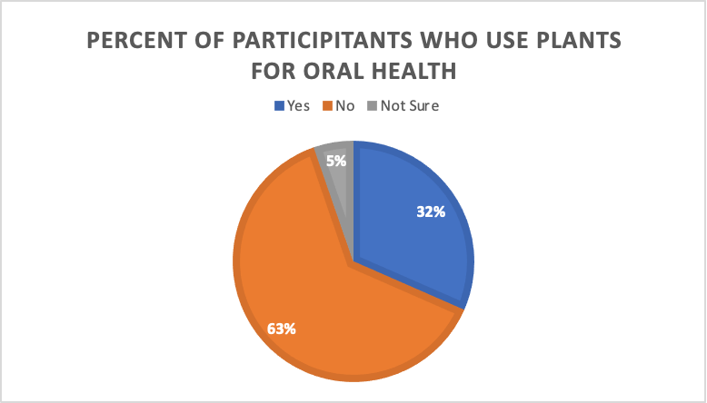
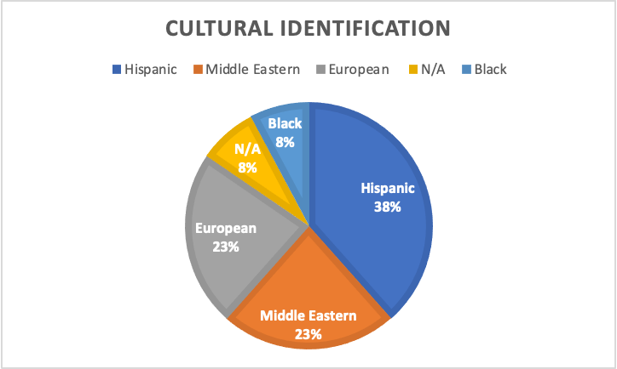
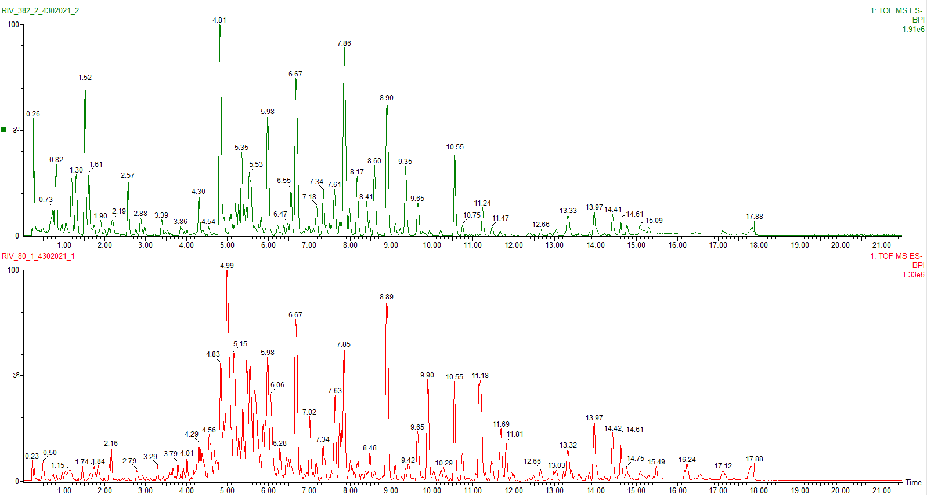
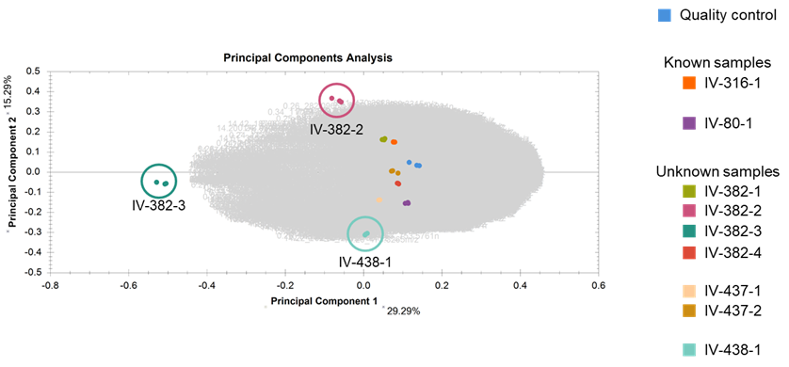
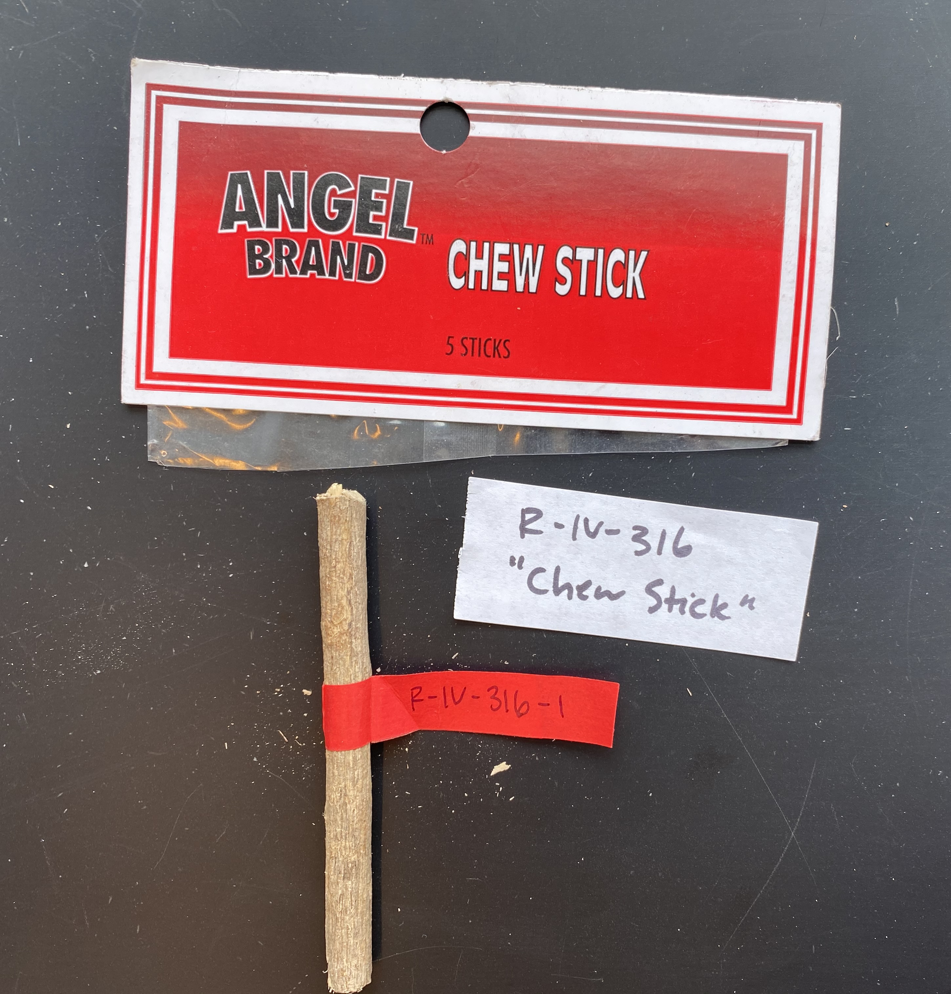
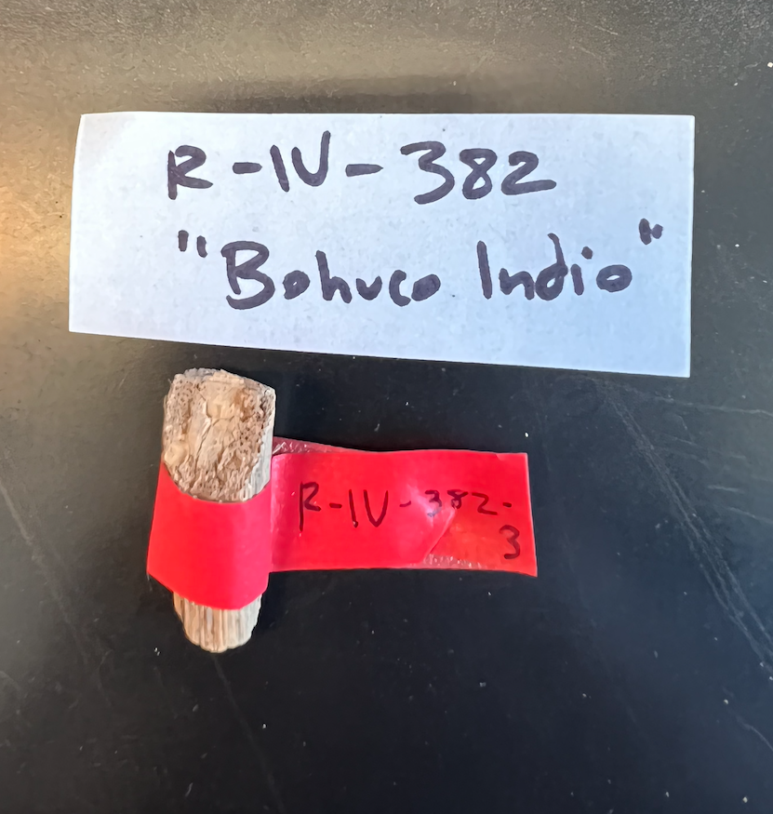
Ethnopharmacology of Bejuco de Indio (Gouania lupuloides), a Caribbean Medicinal Plant Used for Oral Health
Jood Abualiª, Ella Vardeman^{a,b,c}, Ina Vandebroek ^{b,c,d} , Edward Kennelly^{a,c}
ªDepartment of Biological Sciences, Lehman College, City University of New York, Bronx, NY 10468, USA
^{b}The New York Botanical Garden, 2900 Southern Blvd, The Bronx, NY 10458, USA
^{c}PhD Program in Biology, The Graduate Center, City University of New York, 365 Fifth Ave., NY 10016, USA
^{d}Department of Life Sciences and Natural Products Institute, The University of the West Indies Mona, Kingston 7, Jamaica, West Indies
INTRODUCTION
RESULTS
Throughout the Caribbean, Gouania lupuloides (L.) Urb. (Rhamnaceae), is commonly used as a chew stick to clean teeth, remove plaque, and massage gums. Previous research has established that G. lupuloides contains antimicrobial compounds that support its traditional use. Gouania lupuloides is frequently sold as bejuco de Indio in Spanish language Caribbean herbal markets (botánicas) in New York City (NYC). However, as with other herbs of commerce, there is a possibility that chew sticks sold as bejuco de indio are not actually G. lupuloides. The overall aim of this research is to understand the phytochemistry and traditional knowledge of G. lupuloides as it is used in NYC, and to authenticate its botanical identity in commerce. We observed morphological differences between G. lupuloides type specimens and chew sticks sold as bejuco de Indio that may indicate adulteration. Dammarane saponins, such as gouanoside B, which are distinctive of G. lupuloides, have been tentatively identified in type specimens using UPLC-QTOF-MS. Principle component analysis indicates that at least three of the chew stick samples collected as bejuco de Indio are chemically distinct from G. lupuloides type specimens. Our phytochemical analysis aims to characterize a chemical fingerprint typical of G. lupuloides to aid in the chemotaxonomic identification of unknown chew sticks. Additionally, G. lupuloides extracts are being screened against microbes related to its other documented medicinal uses in the Caribbean. An ethnobotanical survey is also being conducted to understand how G. lupuloides, and other herbs of commerce, are used in the NYC area for oral health.
Figure 5. Percent of participants who use plants for oral health (left) and reported cultural-identities of participants with knowledge of medicinal plants (right)
Figure 6. Top three reported uses of plants for oral health
Figure 2. Comparison of chromatograms for unknown sample IV-382-2 (top) and known G. lupuloides sample (IV-80-1)
Figure 7. Sources of medicinal plants for oral health reported by participants
RESEARCH AIMS
From the responses collected at point in the survey, most of the participants did not have knowledge of medicinal plants. However, a majority of those who did report having knowledge of medicinal plant identified as Hispanic from countries like the Dominican Republic, Puerto Rico or Bolivia. Most people reported using medicinal plants as a teeth cleaner or oral rinse and purchased these products in grocery stores.
To understand the the plant chemistry and knowledge of G. lupuloides used in New York.
To determine if adulteration is present in plant identification in botanicas
To understand the general usage of various medicinal plants for oral health
FUTURE DIRECTIONS
MATERIALS & METHODS
We plan to identify marker compounds distinct to G. lupuloides in order to determine a characteristic chemical fingerprint for chemotaxonomic identification.
We plan to continue the ethnobotanical study to reach our target goal of 100 participants to provide qualitative and quantitative data about the use of dental chew sticks in New York.
Phytochemistry
G. lupuloides samples and unidentified chewsticks sold as 'bejuco de Indio' were collected in botanicas in NYC. Samples were validated by botanists at the New York Botanical Garden. Chewsticks were assessed for morphological differences, ground, and extracted in 80% methanol. Crude extracts were syringe filtered and analyzed by liquid-chromatography mass-spectrometry in negative ionization mode. LC-MS data was imported into Progenesis QI and EZInfo to analyze chemical similarities and differences between known and unknown samples.
Ethnobotany
A short Microsoft forms questionnaire (15 minutes) including questions on basic demographic information, use of medicinal plants for oral health, and the species used will be administered to at least 100 participants. Data will be collected without identifiers in a Microsoft Excel sheet and will be used for subsequent data analysis.
Figure 3. PCA Analysis of known and unknown samples of Gouania lupuloides
REFERENCES
Baker, D. A., Stevenson, D. W., & Little, D. P. (2012). DNA barcode identification of black cohosh herbal dietary supplements. Journal of AOAC International, 95(4), 1023-1034.
BARBADOS: Without data (lectotype: Plukenet, Phytographia t. 201(4). 1692). EPITYPE: BARBADOS: Kendal Gully, 24 Mar 1937, McIntosh 333 (epitype: K). Lecto- and epitypified by Pool, Ann. Missouri Bot. Gard 99: 520. 2014.
Elvin-Lewis M. (1983) The antibiotic and healing potential of plants used for teeth cleaning. In: The Anthropology of Medicine.
Romanucci-Ross L, Moerman D, Tancredi L (Eds). South Hadley, MA, Praeger, pp. 201-220.
ETHNOBOTANY AND FLORISTICS OF BELIZE.” NYBG, The New York Botanical Garden, https://www.nybg.org/bsci/belize/Gouania_lupuloides.html.
Kennelly, Edward James. 1993. The ethnobotany and ethnopharmacology of Gouania lupuloides. Washington University, 256 pp. D.A. 54(6):2849-B. Order no. DA9330243.
Lewis WH, Elvin-Lewis MPF. (2003) Medical Botany; Plants Affecting Human Health (2nd ed). Hoboken, NJ, John Wiley &
Sons.
Figure 4. Abundance of Unidentified marker compounds in known samples (IV-80 and IV-316) and unknown sample
(IV-382-2)
There were differences in texture, color and morphology in known and unknown chew sticks samples (Figure 1). These differences were supported by PCA analysis, which identical at three of the chewsticks (two samples from IV-382 and one from IV-438) were chemically distinct from the other chewsticks, including those known to be G. lupuloides. This indicated that there may adulteration or misidentification of chewsticks sold as 'bejuco de Indio' in NYC. Further analysis in EZInfo, identified marker compounds that differed significantly between chemically distinct samples. Further investigation and identification of these compounds is in progress to determine a chemical fingerprint for G. lupuloides chewsticks in NYC.
ACKNOWLEDGMENTS
Special thanks to all peer members in Dr. Edward Kennelly’s laboratory and RISE research mentors and peers. I would like to acknowledge the New York Botanical Garden for providing the chewstick samples, particularly Dr. Ina Vandebroek and her help with the chewstick collection. Additionally, a special thanks to NYC LSAMP and the NSF for funding my research.
Figure 1: Identified
Gouania lupuloides
IV-316-1 (top) and unknown bark sold as "Bejuco de Indio" IV-382-3
.

