Slide 1
LANTHANIDE LUMINESCE for BIOIMAGING: SYNTHESIS and CHARACTERIZATION of DO2A-TRIAZOLO[3,4-]PHTHALAZINE
Anthony Calderon
CUNY Lehman College
Department of Chemistry
Benjamin Burton-Pye and William Centeno
Funding ID:NIH SC3 GM122654A

Slide 2
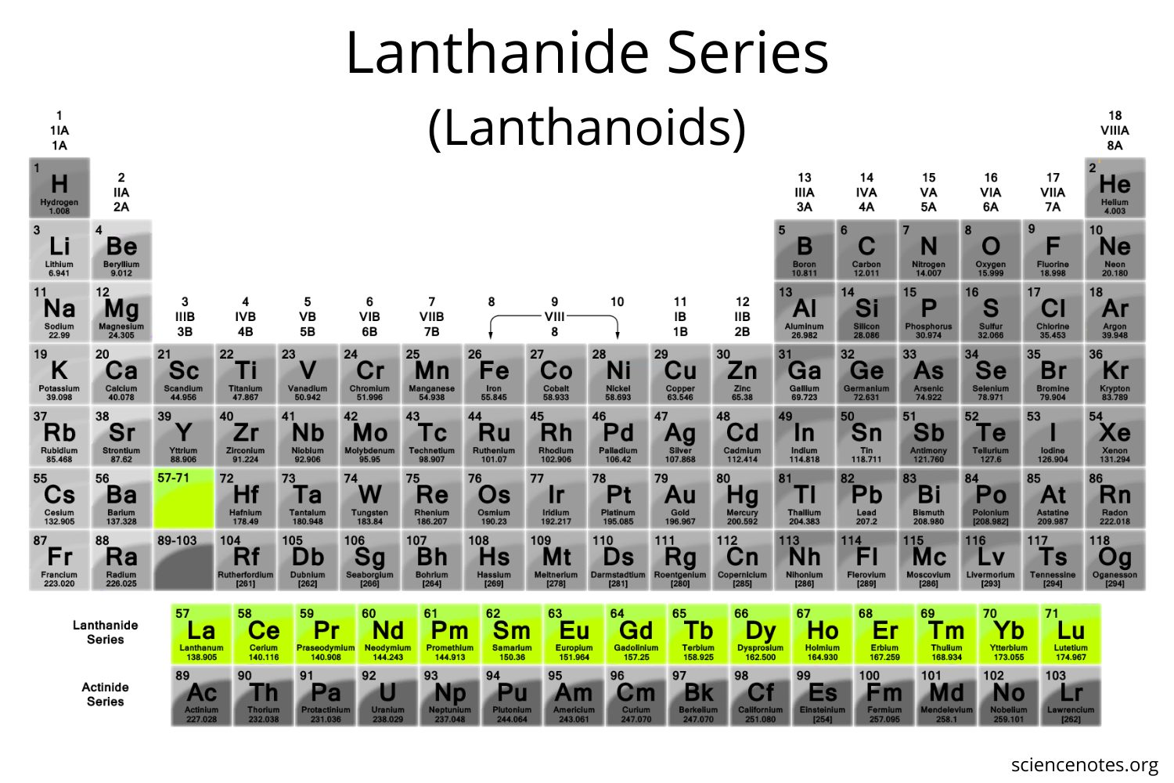
What are Lanthanides?
Are elements part of the Lanthanide series on periodic table
Consists of 15 metallic elements
These elements have their 4f sublevel filled.
Notes:
Have many purposes. (Alloy)
Lanthanides have similarities in their physical and chemical properties

Slide 3
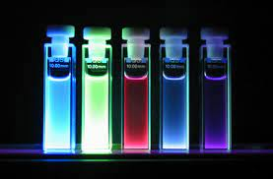
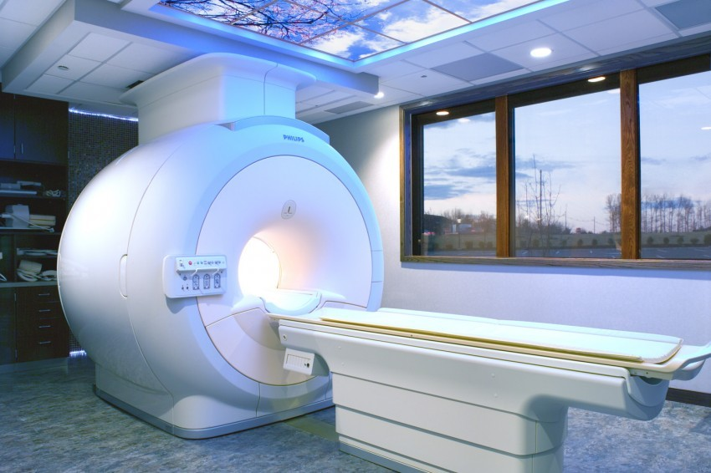
Why Lanthanides?
Lanthanide complexes are useful as bioimaging agents due to their long-lived excited states (fluorescence)
Are also paramagnetic and used in MRI
Notes:
Lanthanides are emissive and have long luminescence lifetimes

Slide 4
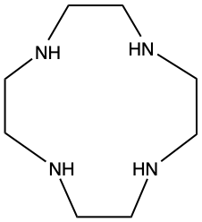
Lanthanide Complex
To take advantage of these properties, lanthanide ions (L³⁺) must be complexed.
We used the macrocycle 1,4,7,10-tetraazacyclododecane (cyclen) as our ligand backbone.
Notes:
by a ligand in order to enhance light absorption.

Slide 5
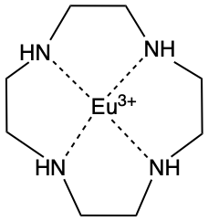
Why Cyclen?
Cyclen bears 4 nitrogen donor atoms that can be easily modified with more chelating groups.
Lanthanide ions have coordination numbers of 8-10.
Can add appendages to the nitrogen atoms.
Notes:
Bind the lanthanide effectively
Can act as antennas to harvest light and increase luminescence emission
We used Europium Eu^3+ as our lanthanide.

Slide 6
The Issue with Lanthanide Luminescence
Notes:
While Lanthanides can retain light for long lifetimes, they are actually quite poor at initially absorbing light

Slide 7
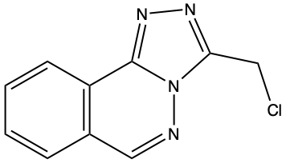
Solution to Lanthanide Absorption
In order to aid the lanthanides to absorb light more effectively we can attach specific appendages to the ligand
3-chloromethyl triazolo[3,4-]phthalazine our first appendage.
Notes:
Our first appendage is an antenna

Slide 8
Synthesis of Phthalazine
Notes:
Hydralazine hydrochloride and with H2O to yield a yellow solution.
Add chloroacetyl chloride dropwise.
Reflux overnight → white precipitate
Filtered and dry to collect product

Slide 9
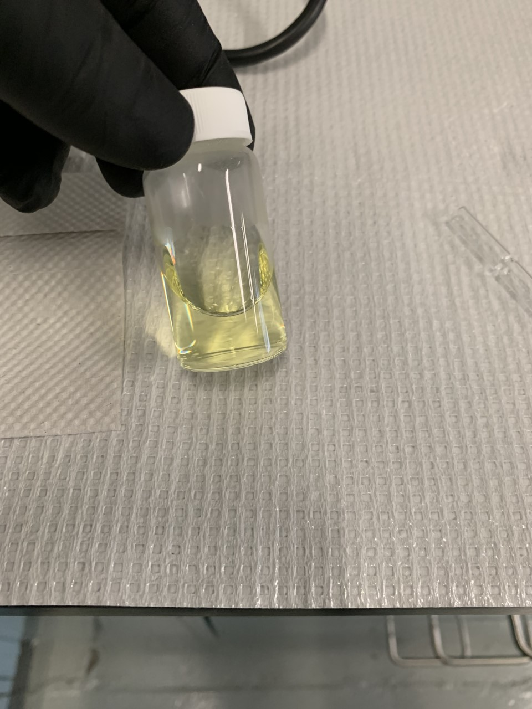
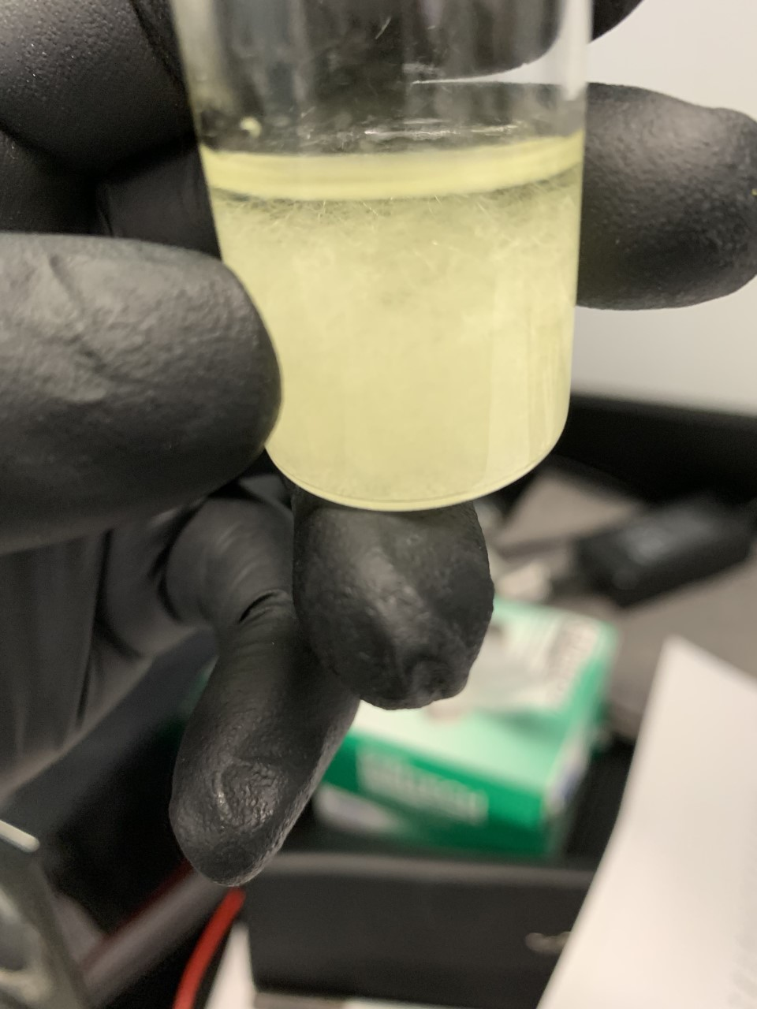
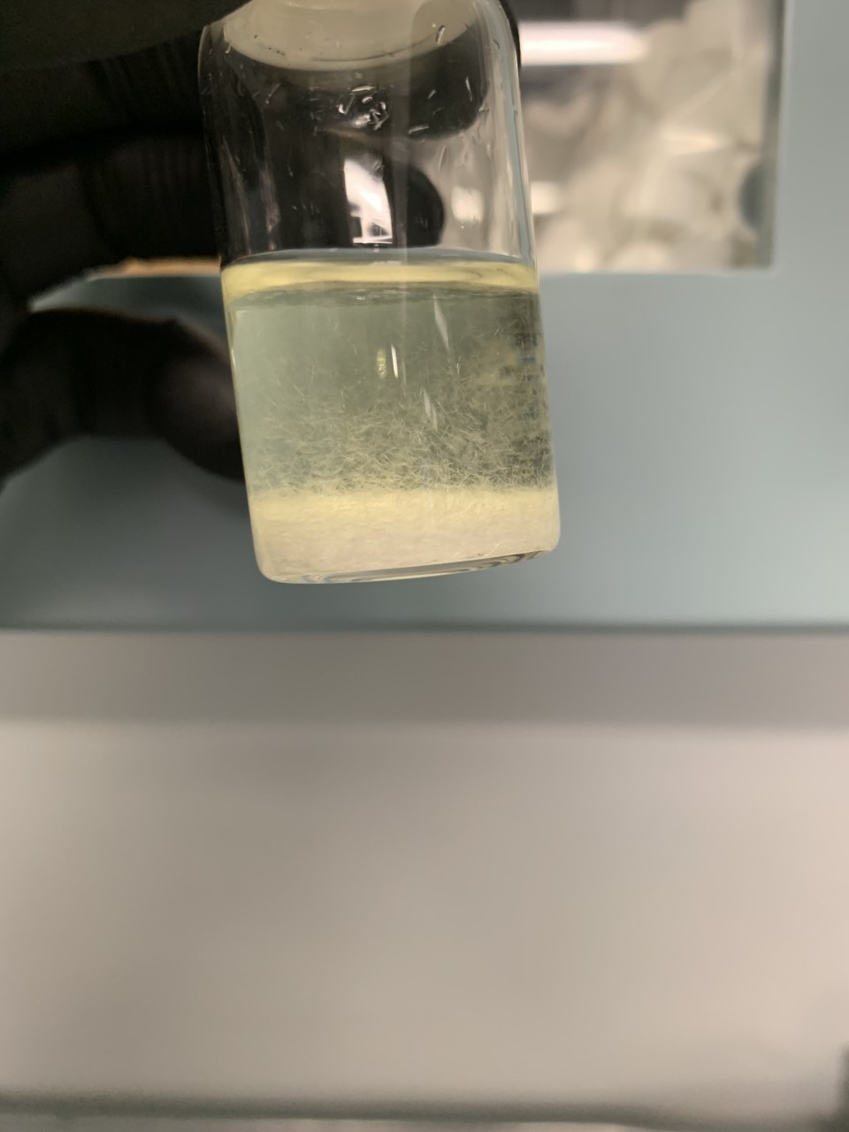
Synthesis of Phthalazine (cont.)
Phthalazine in EtOH
Notes:
Reagents
Adding teh chloride dropwise
Final product in etoh

Slide 10
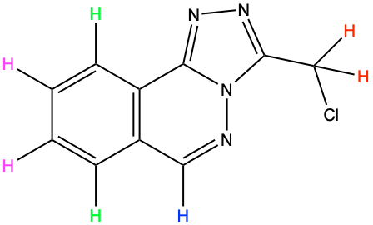
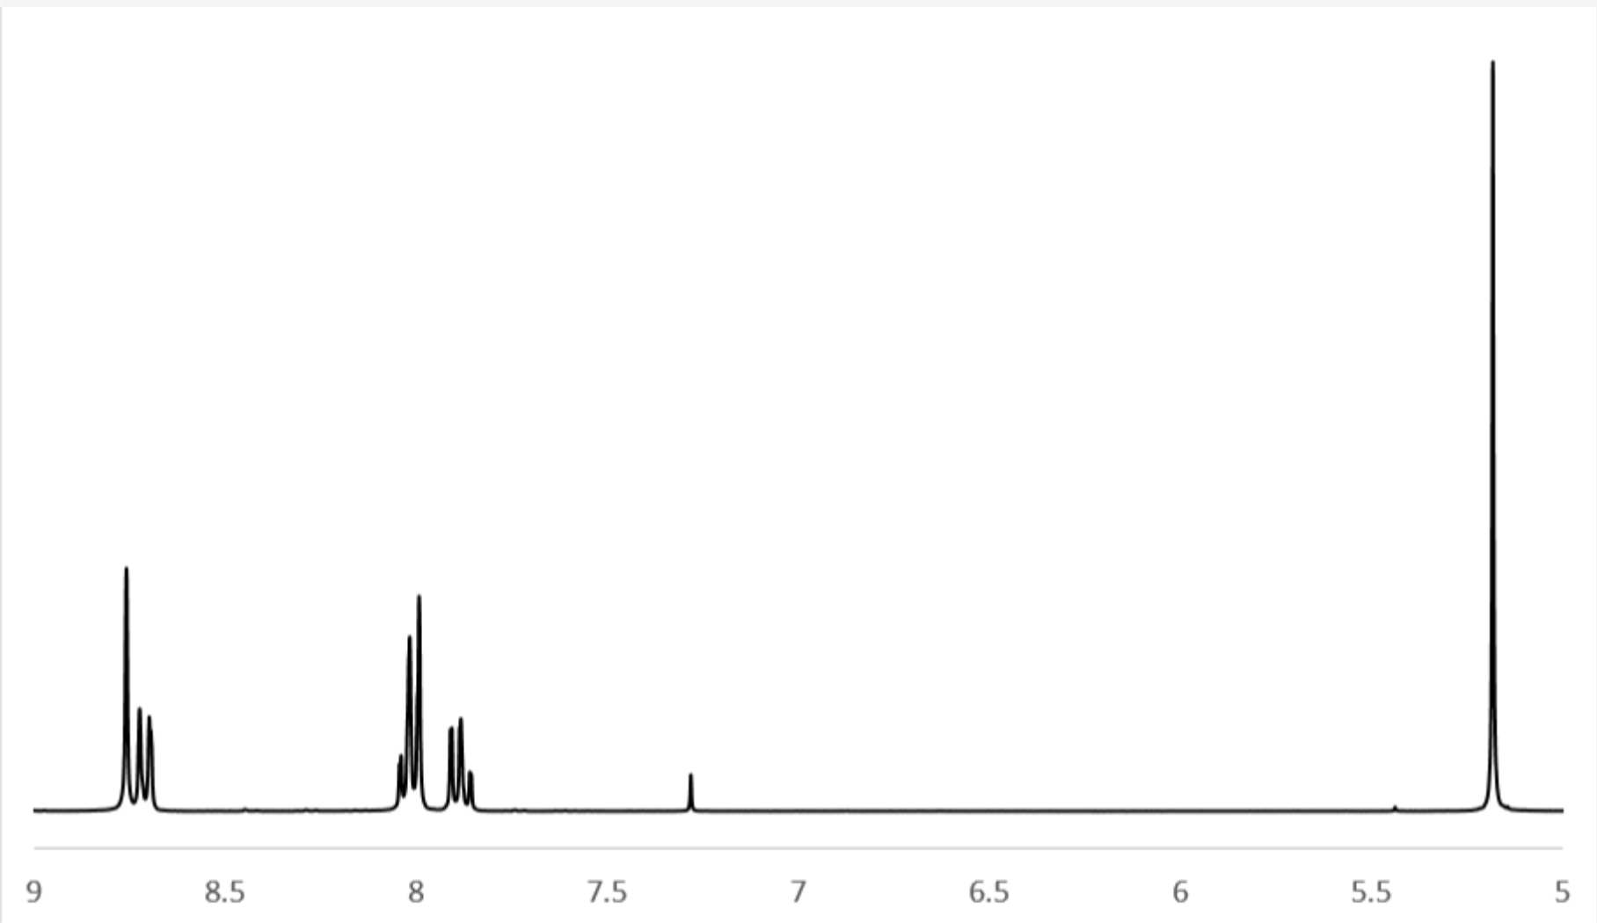
H-NMR of Phthalazine
2H
2H
1H
2H
2H: 5.19 Peak
2H: 7.91 Peak
2H: 8.04 Peak
1H: 8.79 Peak
ppm
Notes:
To make sure we have our product we Characterize it product via H-NMR. NMR distinigues all the unique hyrdogens in a compound
Match peaks on procedure
Most of the peaks in aromati region- rings
The unlabeled peak at 7.3 is our CDCl3 solvent peak

Slide 11
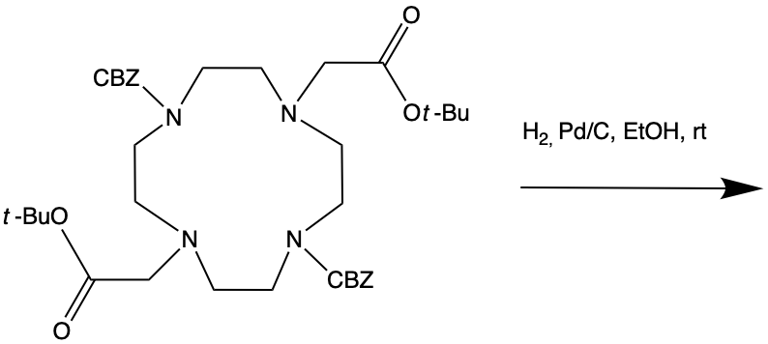
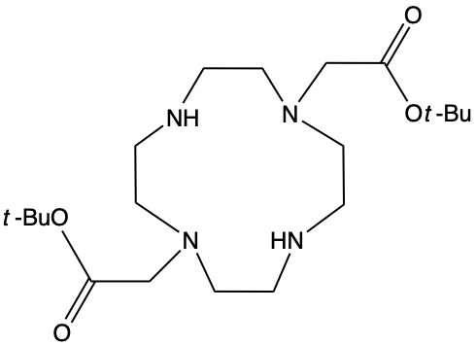
Synthesis of DO₂A-t-Bu ester
DO2A-t-Bu ester
Notes:
More complex than the phthalazine synthesis. The acetate arms help BINDS LANTHANIDE
Carried out in 3 steps
2 amines of the cyclen are protected by adding the CBClZ (. These protecting groups will enable us to add the appendages in teh next step
We reacted T-bu bromoacetate w/ the CBZ- cyclen in presence of DIEA to produce the macrocycle.
We removed the CBZ via hydrogenation. to give our product as a light yellow oil.

Slide 12
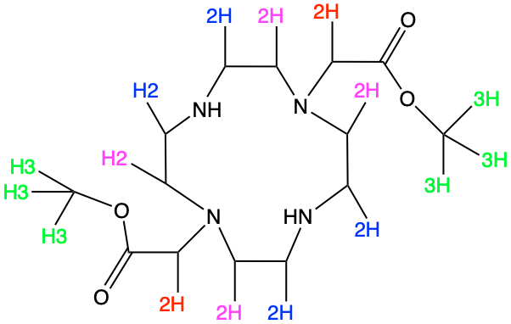
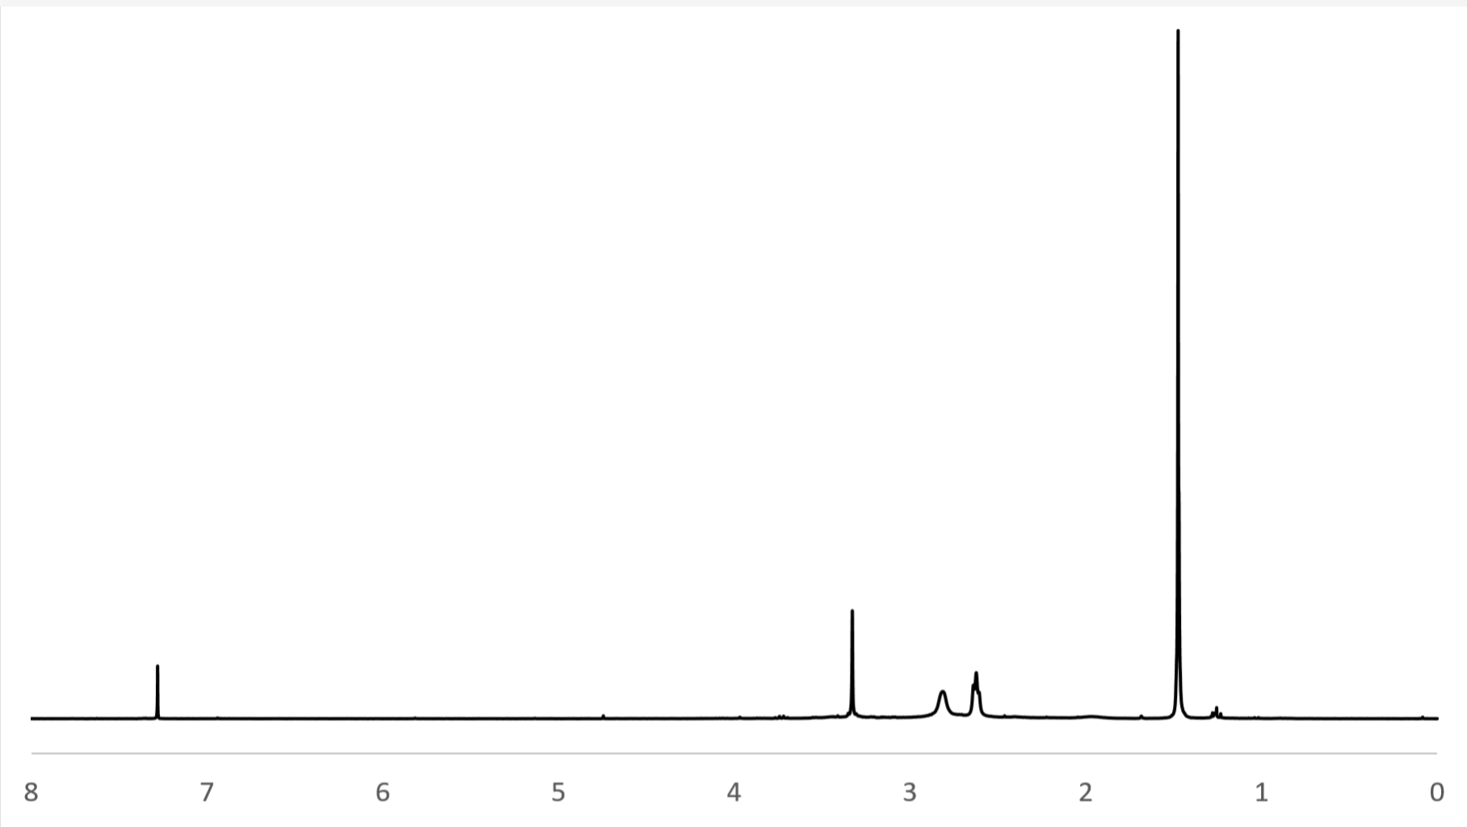
NMR of DO₂A-t-Bu ester
18H
8H
8H
4H
4H: 3.31 Peak
8H: 2.82 Peak
8H: 2.63 Peak
18H: 1.45 Peak
ppm
Notes:
Characterize our product via H-NMR.
Match peaks on procedure

Slide 13
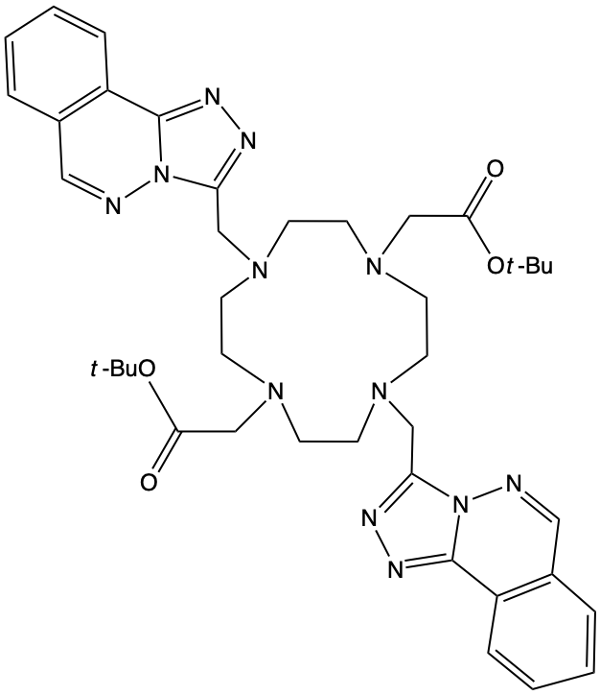
DO₂A-TRIAZOLO[3,4-]PHTHALAZINE
Notes:
We add the Phthalazine to our DO2A-t-bu Ester to result in our ligand. As seen we used all of the 4 N donating atoms available in the cyclen.

Slide 14
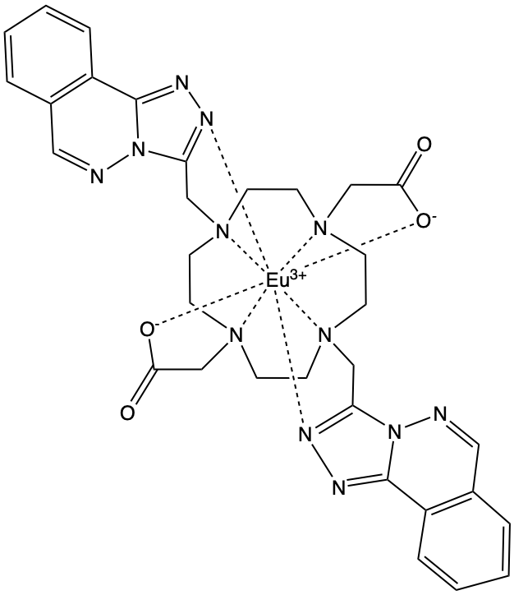
DO₂A-triazolo[3,4-]phthalazine Lanthanide Complex
Notes:
Our Eu will be situated in our ligand. When adding the ligand we also need to deprotect the acetate arms. (take away the t-butyl). This gives us the O- at the ends of the acetate arms. This is done so the resulting charge can bind the lanthanide. If we count the coordination bonds we get coordination number of 8, which satisfies the lanthanide ion.

Slide 15
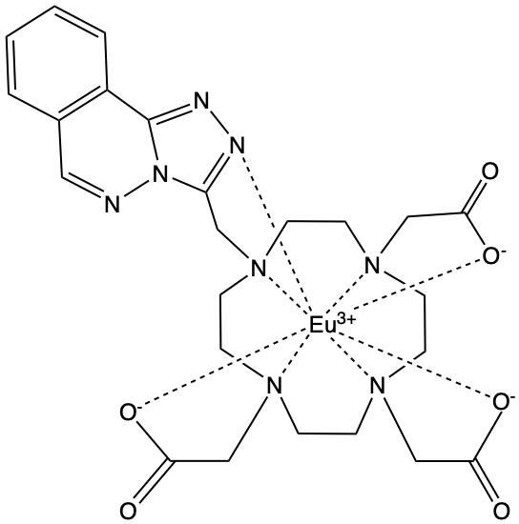
DO₃A-triazolo[3,4-]phthalazine Lanthanide Complex
Notes:
Previous studies show that complexes of DO3A-triazolo[3,4-]phthalazine show good luminescent properties and we want to investigate the behavior of complexes of DO2A-triazolo[3,4-]phthalazine to compare. As seen the only difference between the complexes is that we replaced a phthalazine arm with an acetate arm. In the next slide we will go over luminescent properties of these two complexes. We hypothesized that the DO2A would be more luminescent as its structure contains 2 “antennas” while the DO3A only has 1 “atenna”, so the DO2A would absorb light more efficiently.

Slide 16
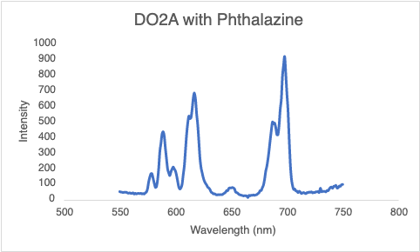
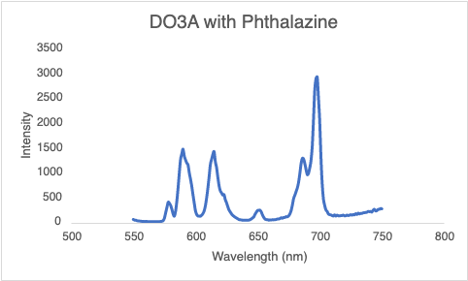
Excitation Spectras
Notes:
Here we have our excitation spectras of our two complexes so we can compare their luminescence propoerites. Eu edmits light at wavelengths 550-750 which is why both complexes.

Slide 17
Thank You!

